Slide 1


ADME Modeling and Prediction for Non-Human Pharmaceutical Lead Screening - Cargill, Inc.
Sara Aalinezhad (Department of Chemical Engineering, UW)
Yuxuan Ren (Department of Chemical Engineering, UW)
Salek Segid (Department of Chemical Engineering, UW)
Liwen Xing (Molecular Engineering & Sciences Institute, UW)

Slide 2
Outline
Background
Data extraction
Data cleaning and processing
Machine learning model
Conclusion and future direction

Slide 3
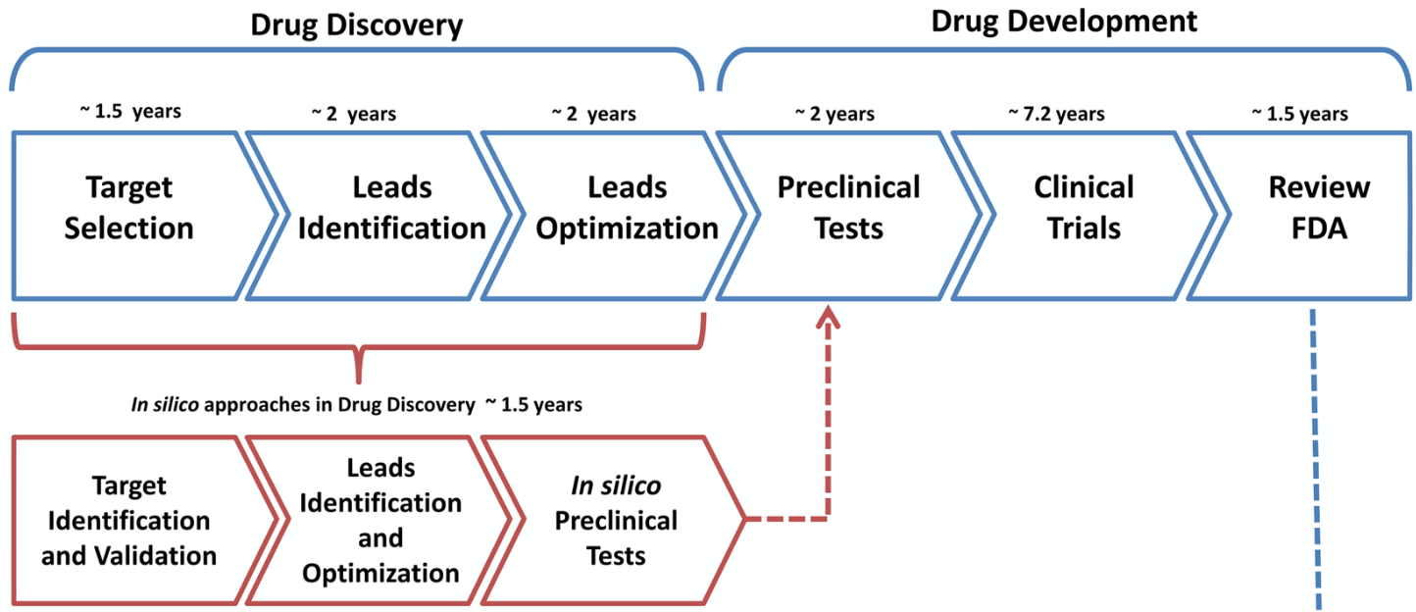
Background
In silico approach can potentially shorten the drug discovery process by 3 to 4 years.
ADME/Tox modeling predicts the absorption, distribution, metabolism, excretion, and toxicity of the drug candidates.
Train the machine learning model with existing experimental data
Approved drug
Rocha-Roa C, Molina D and Cardona N (2018) A Perspective on Thiazolidinone Scaffold Development as a New Therapeutic Strategy for Toxoplasmosis. Front. Cell. Infect. Microbiol. 8:360.

Slide 4
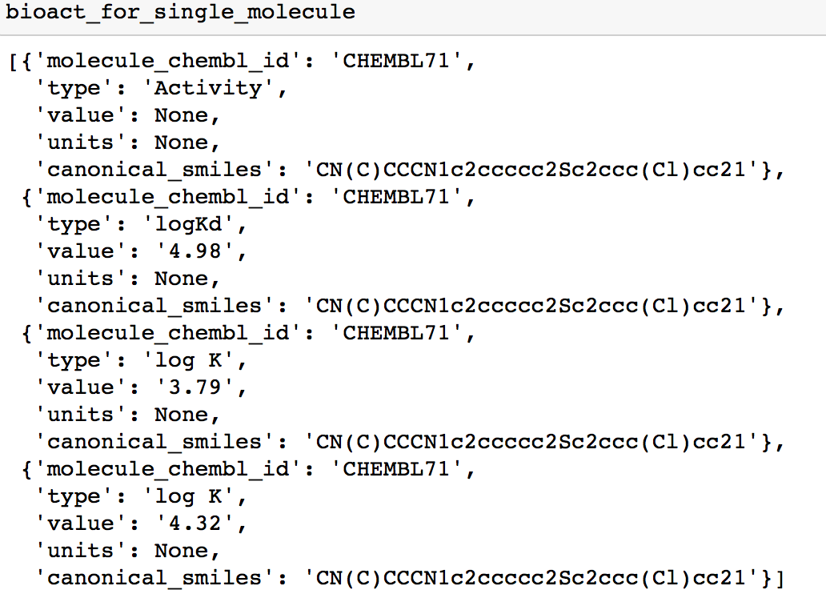
Data extraction
Challenges we encountered while extracting the data using ChEMBL official Python client library:
Difficult to extract biotherapeutic data along with farm animals as target
The bioactivity data were inconsistent for a single molecule

Slide 5
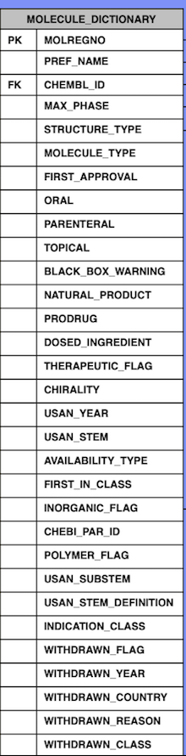
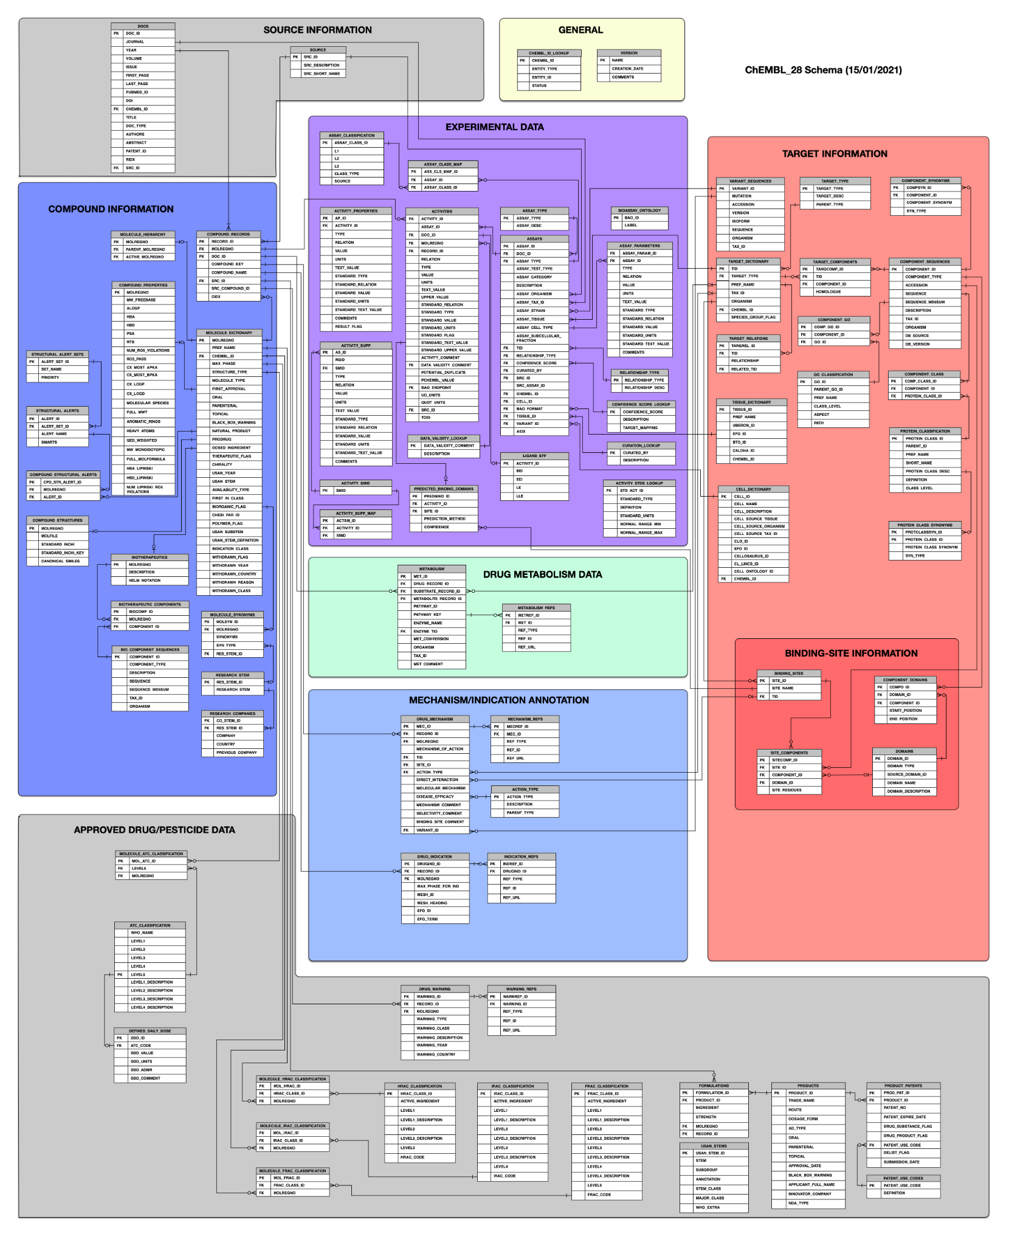
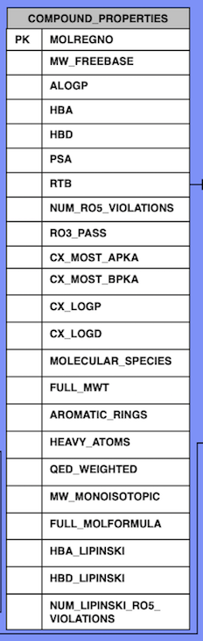
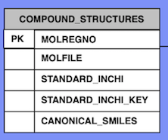
Data extraction
Compound Information
logS, molecular weight, Lipinski ‘Rule of Five’ parameters for druglike compounds
We chose SQLite to extract data from database

Slide 6
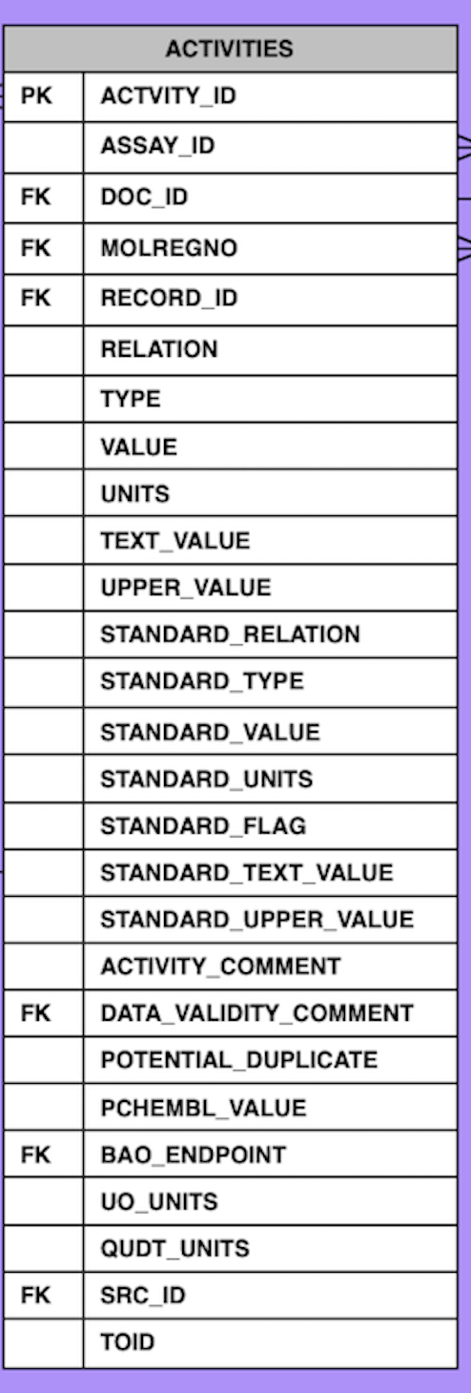
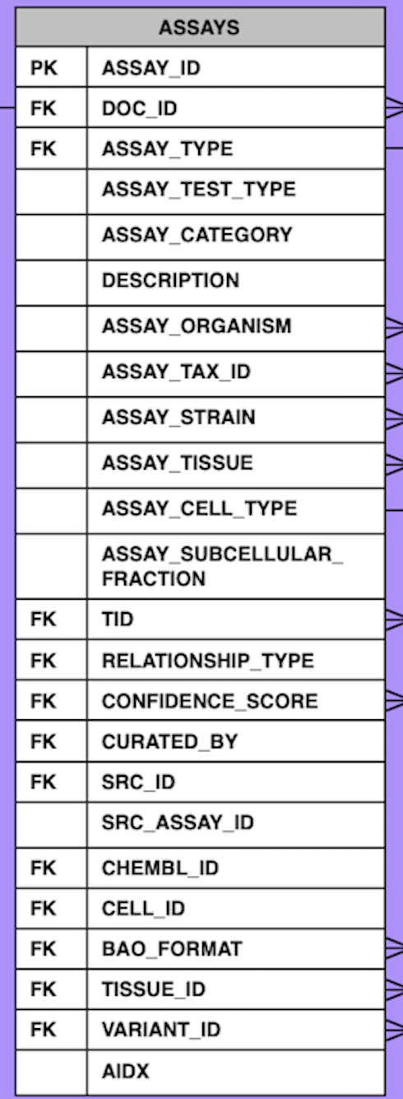
Data extraction
Experimental Data
ADME Assay
Bioactivity Data

Slide 7
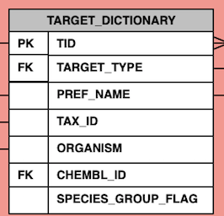
Data extraction
Target Information
The schema is very big and the size of database is around 20GB

Slide 8
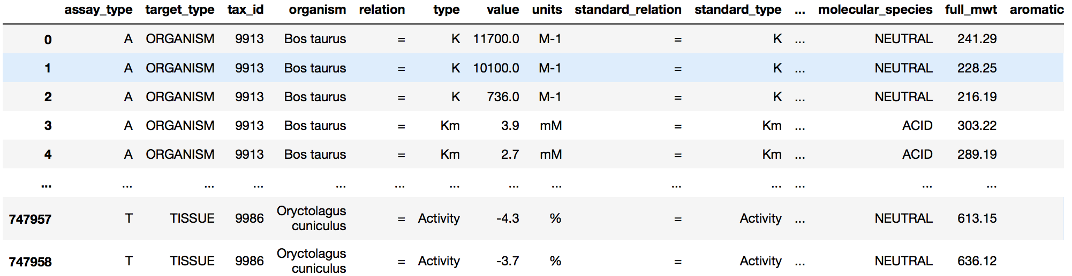
Data extraction
An example of raw dataframe extracted from ChEMBL database
ADME and toxicity assays
6 different organisms: cow, pig, sheep, brown rat, house mouse and rabbit

Slide 9
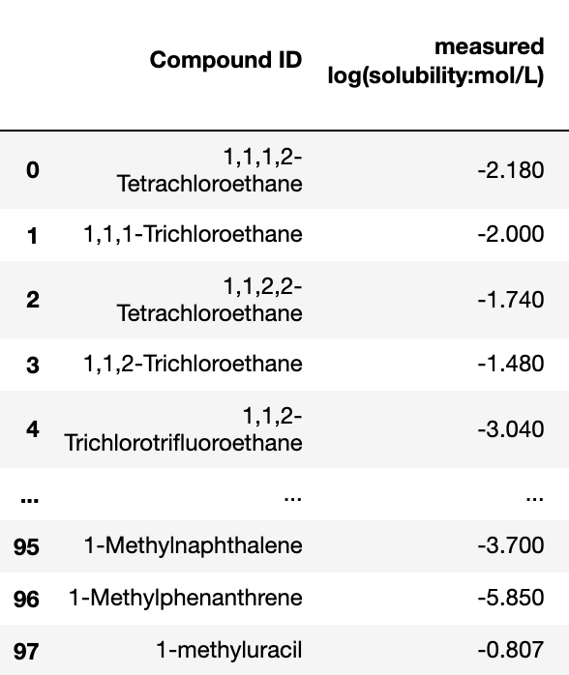
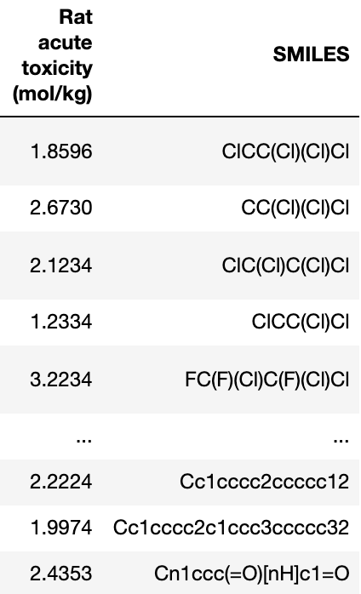
Data cleaning and processing
ADME/Tox features
The data format accessible to the machine learning model:
Headers of the data frame -
Molecule unique ID
Different ADME/Tox features
SMILE Strings
Data in the dataframe -
Numerical numbers under ADME/Tox features
Strings under chemical ID and SMILES strings

Slide 10
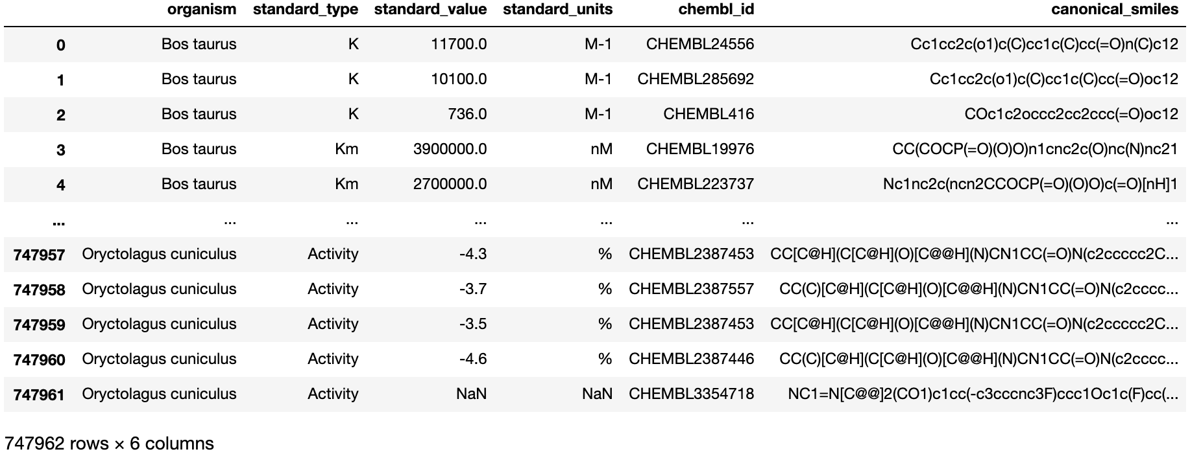
Data cleaning and processing
Raw data extracted from ChemBL database:
Challenges:
ADME/Tox features are not on column headers
The units are not unified for the same feature
There are repetitive compounds
Every compound has different types and different numbers of ADME/Tox features

Slide 11
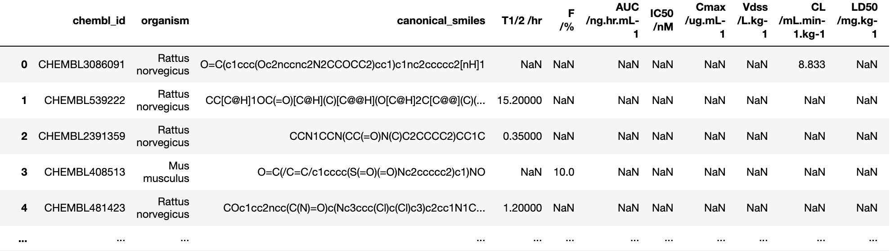
Data cleaning and processing
After cleaning and reorganizing the data frame (and units were unified):
Common and important ADME/Tox features we picked for our model to predict
We decided to make individual data frame for each ADME/Tox feature to make sure there are enough molecules to train the model without having NaN values.
Too many NaNs because every compound has different types and different numbers of ADME/Tox features

Slide 12
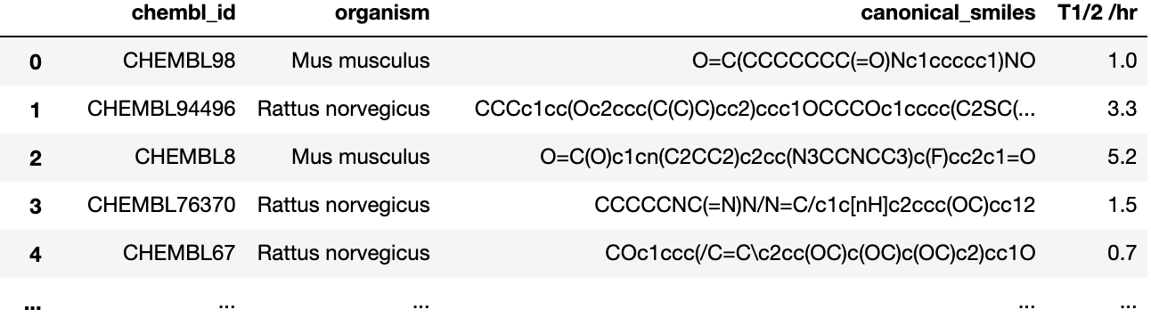
Data cleaning and processing
An example of the data frames accessible to the machine learning model:
The data for elimination half life time (T1/2)

Slide 13
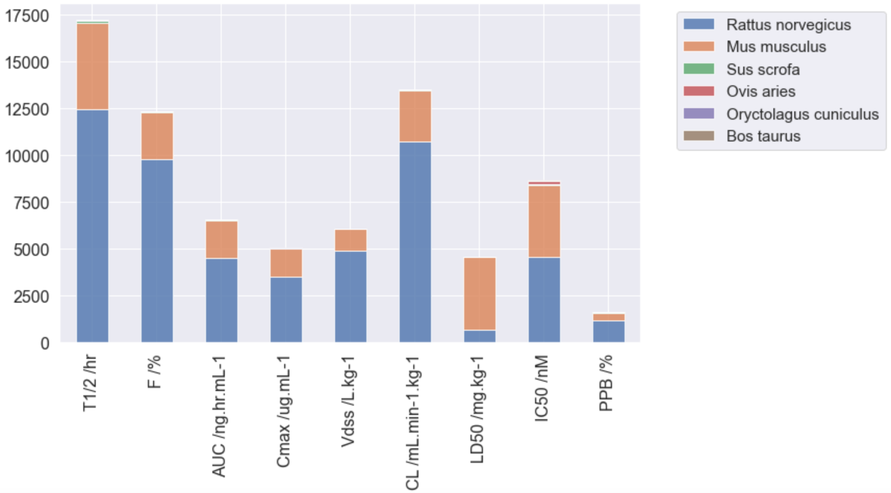
Data cleaning and processing
Contributions from different organisms to each ADME/Tox feature:
Most data were obtained from Rattus norvegicus (brown rats) and Mus musculus (house mouse)

Slide 14
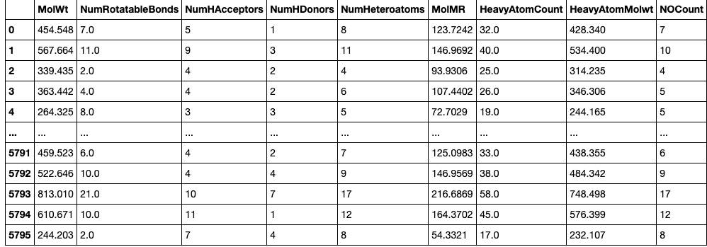
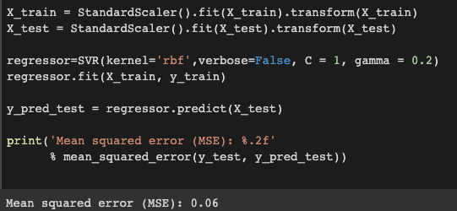
Machine learning model
Rdkit package was used to calculate Molecular Descriptors
Over 80 descriptors were calculated and then narrowed down to 52 of them that gave good representation
How we predicted the drug half-time (T1/2)
Some of the molecular descriptors calculated

Slide 15
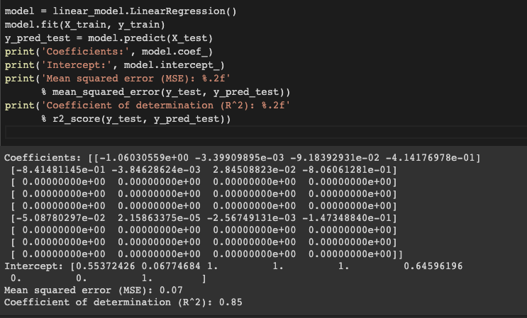
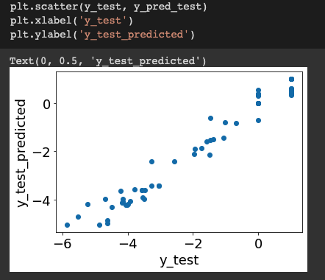
Machine learning model

Slide 16
Conclusion and future direction
Different scikit learn regression algorithms were used and got mixed predictions
Low MSE and good correlation
Successful prediction overall
The models can be trained on different types of data for future use
Hyperparameter tuning is required

Slide 17

Acknowledgement
Panagiota Kyriakou, Cargill, Inc.
Prof. David A. C. Beck
Prof. Daniel T. Schwartz
Everyone in the DIRECT program

